Slide 2
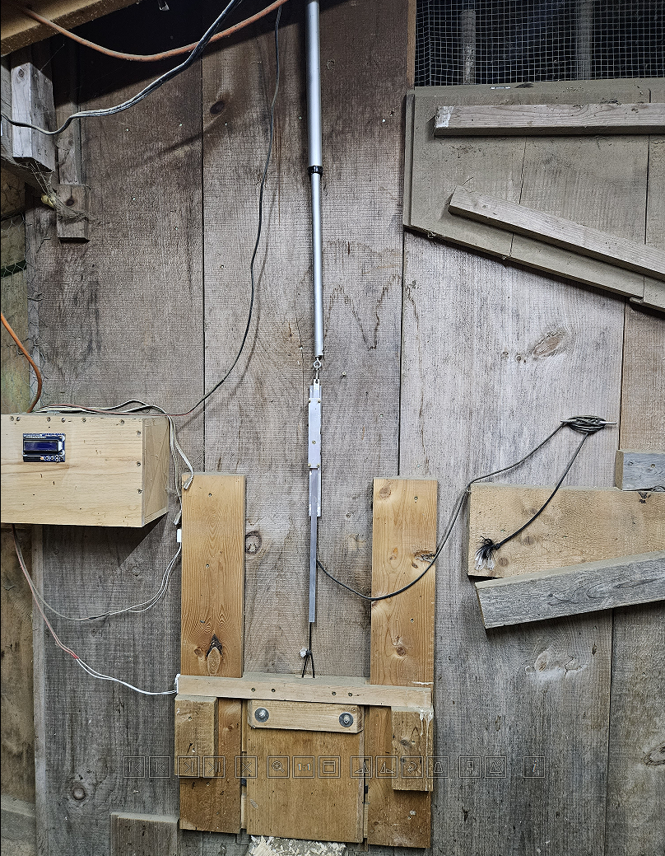
Door Linear Actuator
Controller Enclosure & Display
Slip Connection
Controller Enclosure & Display
Reed Switches
Door

Slide 3
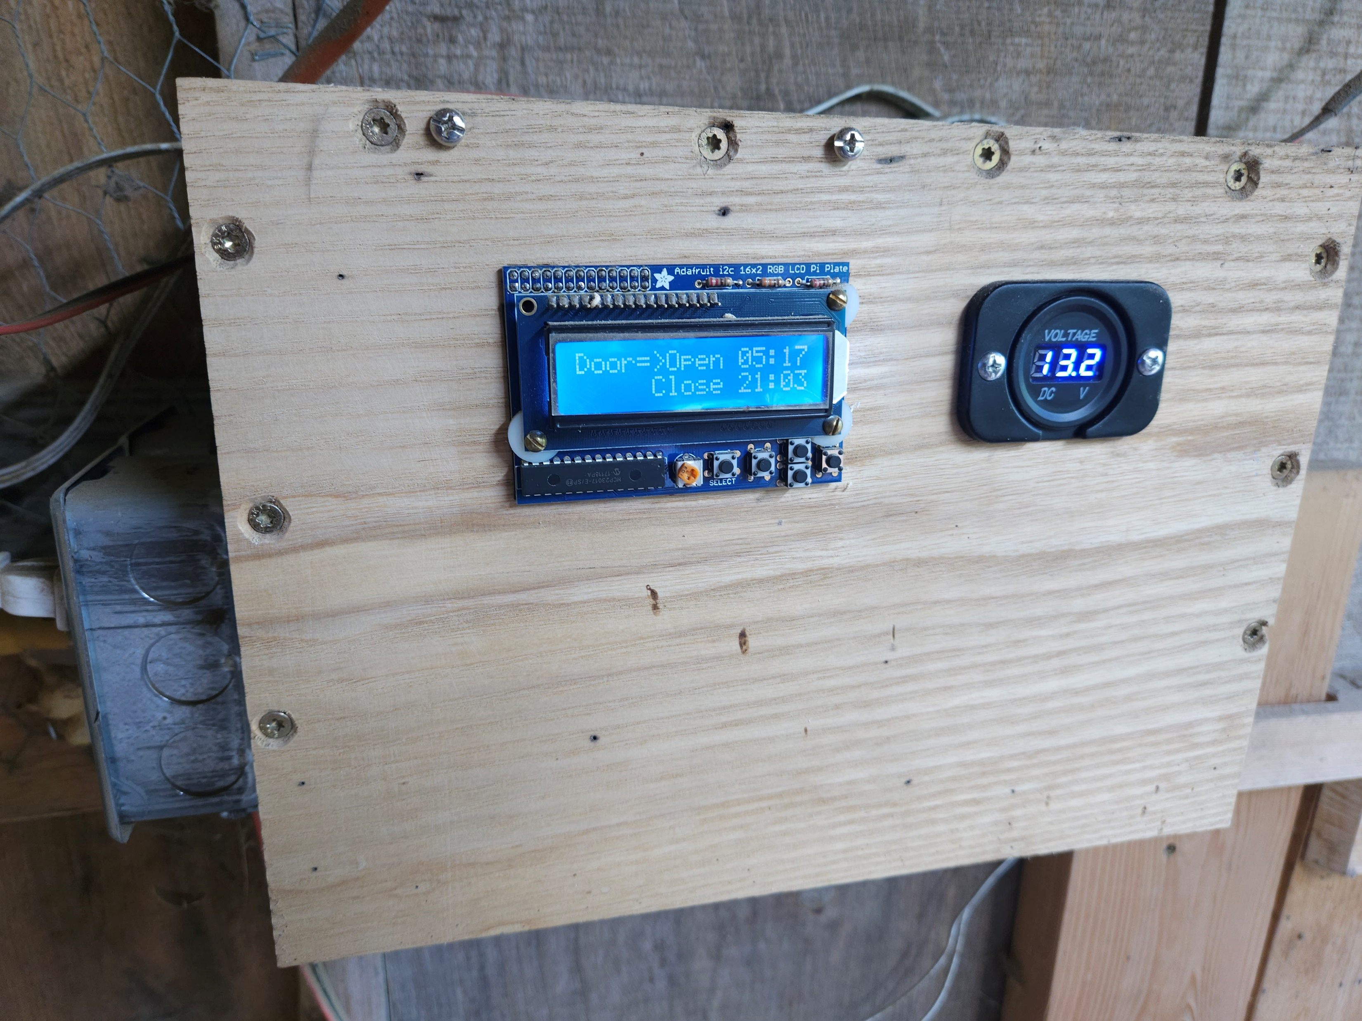
12V-Battery Monitor
Display & Menu Controls
Raspberry Pi Controlled Outlet (for lights)

Slide 4
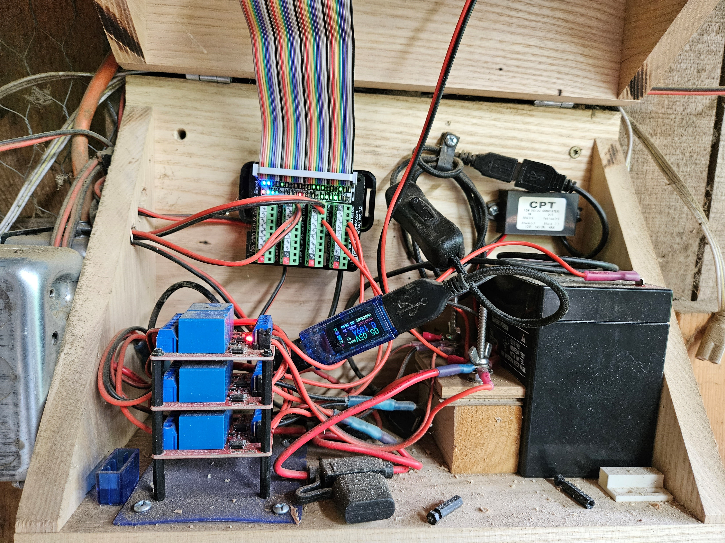
Data Ribbon for Display
Raspberry Pi on/off Switch
USB power supply
Raspberry Pi
USB voltage & current monitor
Original battery (was too small; superseded with marine deep cycle battery)
Solenoid stack (door open/close & light on/off)
12V positive and negative connection blocks
Fuse

Slide 5
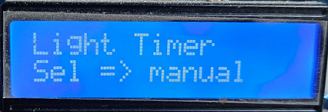
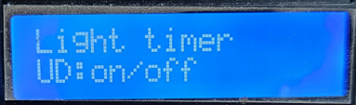
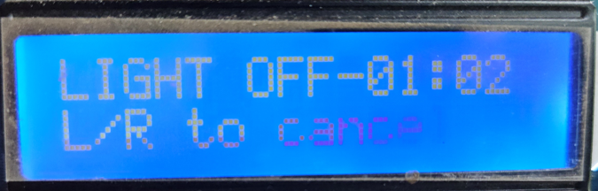
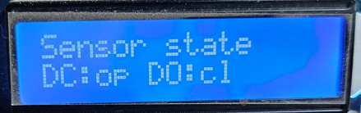
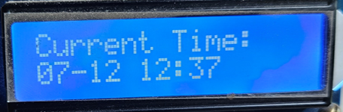
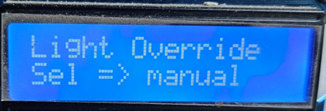
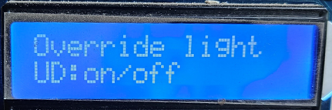
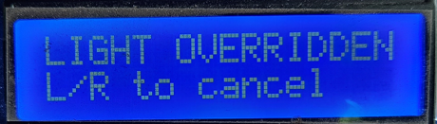
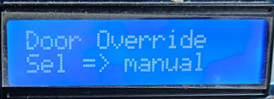
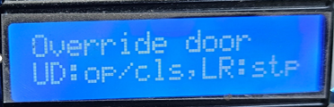
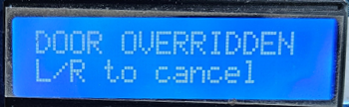
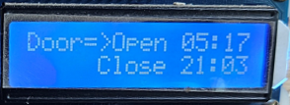
Primary Menu Display
Sub-menu Display
Alt. Menu Display
Menu 6
Sel
Up/Down
Menu 5
Up/Down
Menu 4
Up/Down
Up/Down
Menu 3
Sel
Up/Down
Menu 2
Sel
Up/Down
Menu 1

Slide 6
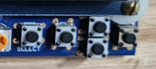
Up
Select
Left
Right
Down

